Slide 1
Blackjack - A Family Game
By: Dane Jarvis, Jacob Wenz, Zach Michelson

Slide 2
Rules of Blackjack
If player has over 21; it's a bust and the dealer wins
If player stands, and dealer busts- then player wins
If the dealer and player tie, it's a push and the player receives their bet back

Slide 3
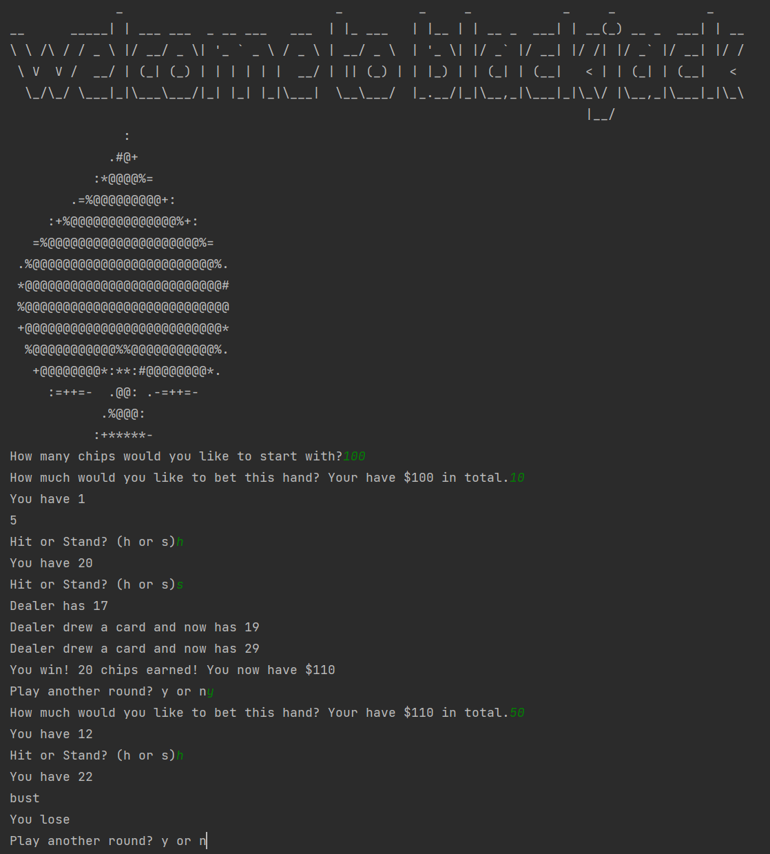
User Interface
At the beginning of the game it welcomes you, and asks the starting chips
After every hand it shows the total chips you have remaining and asks the bet for the hand
Asks the user if they would like to hit or stand after each draw and outputs the dealers current hand
s: Stand
h: Hit

Slide 4
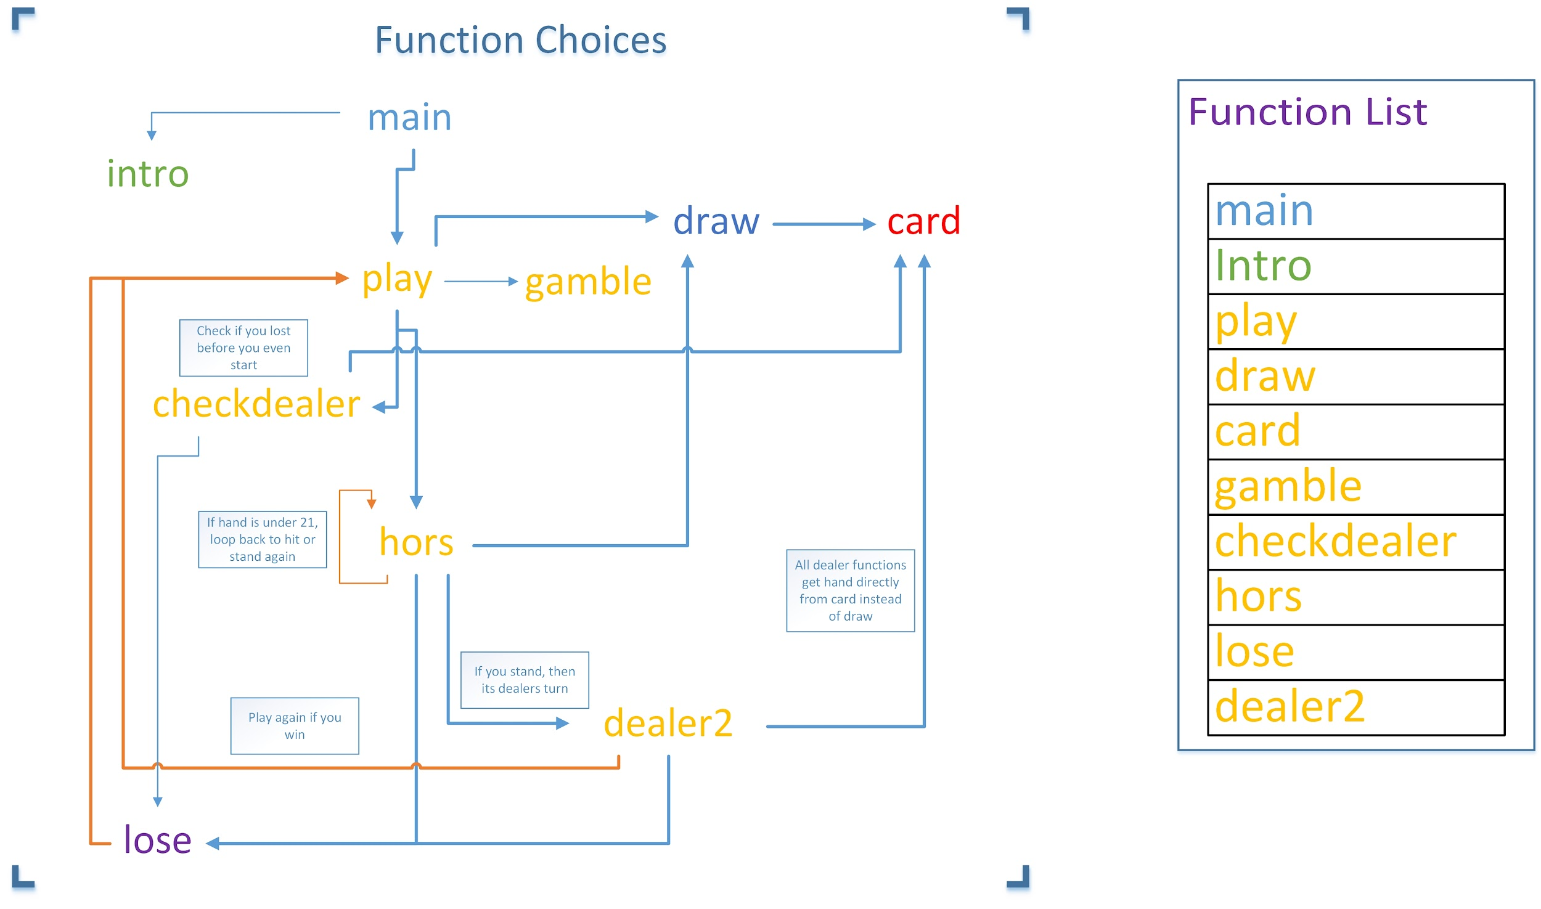

Slide 5
Functions
intro: the introduction to the game, and asks for the amount of starting chips and assigns it to total
gamble: Asks the user how much they would like to bet, and checks that they don't bet more than their total amount
lose: Asks the player if they would like to play again, and sets bet to 0 to reset the variable
dealer2: checks if the dealers hand is greater than the players but less than 21, essentially a function determining who wins
hors: asks the user if they would like to hit or stand after each turn
card: finds the value of the card that is pulled out of the deck
checkdealer: finds and outputs the dealers hand and outputs it to the user
play: outputs the first hand to the player
main: starts the intro and play functions
draw: outputs the additional cards to the player when they hit

Slide 6
Variables
total- The total amount of chips - global
bet- The bet for the current hand - global
hand-The hand of the player - global
dealerhand- The current hand of the dealer, which is then output - global
card_face-Used as a placeholder to get the value from the draw function - local
choice-Used in a boolean to ask the user if they would like to hit or stand - local
Plus countless other local variables

Slide 7
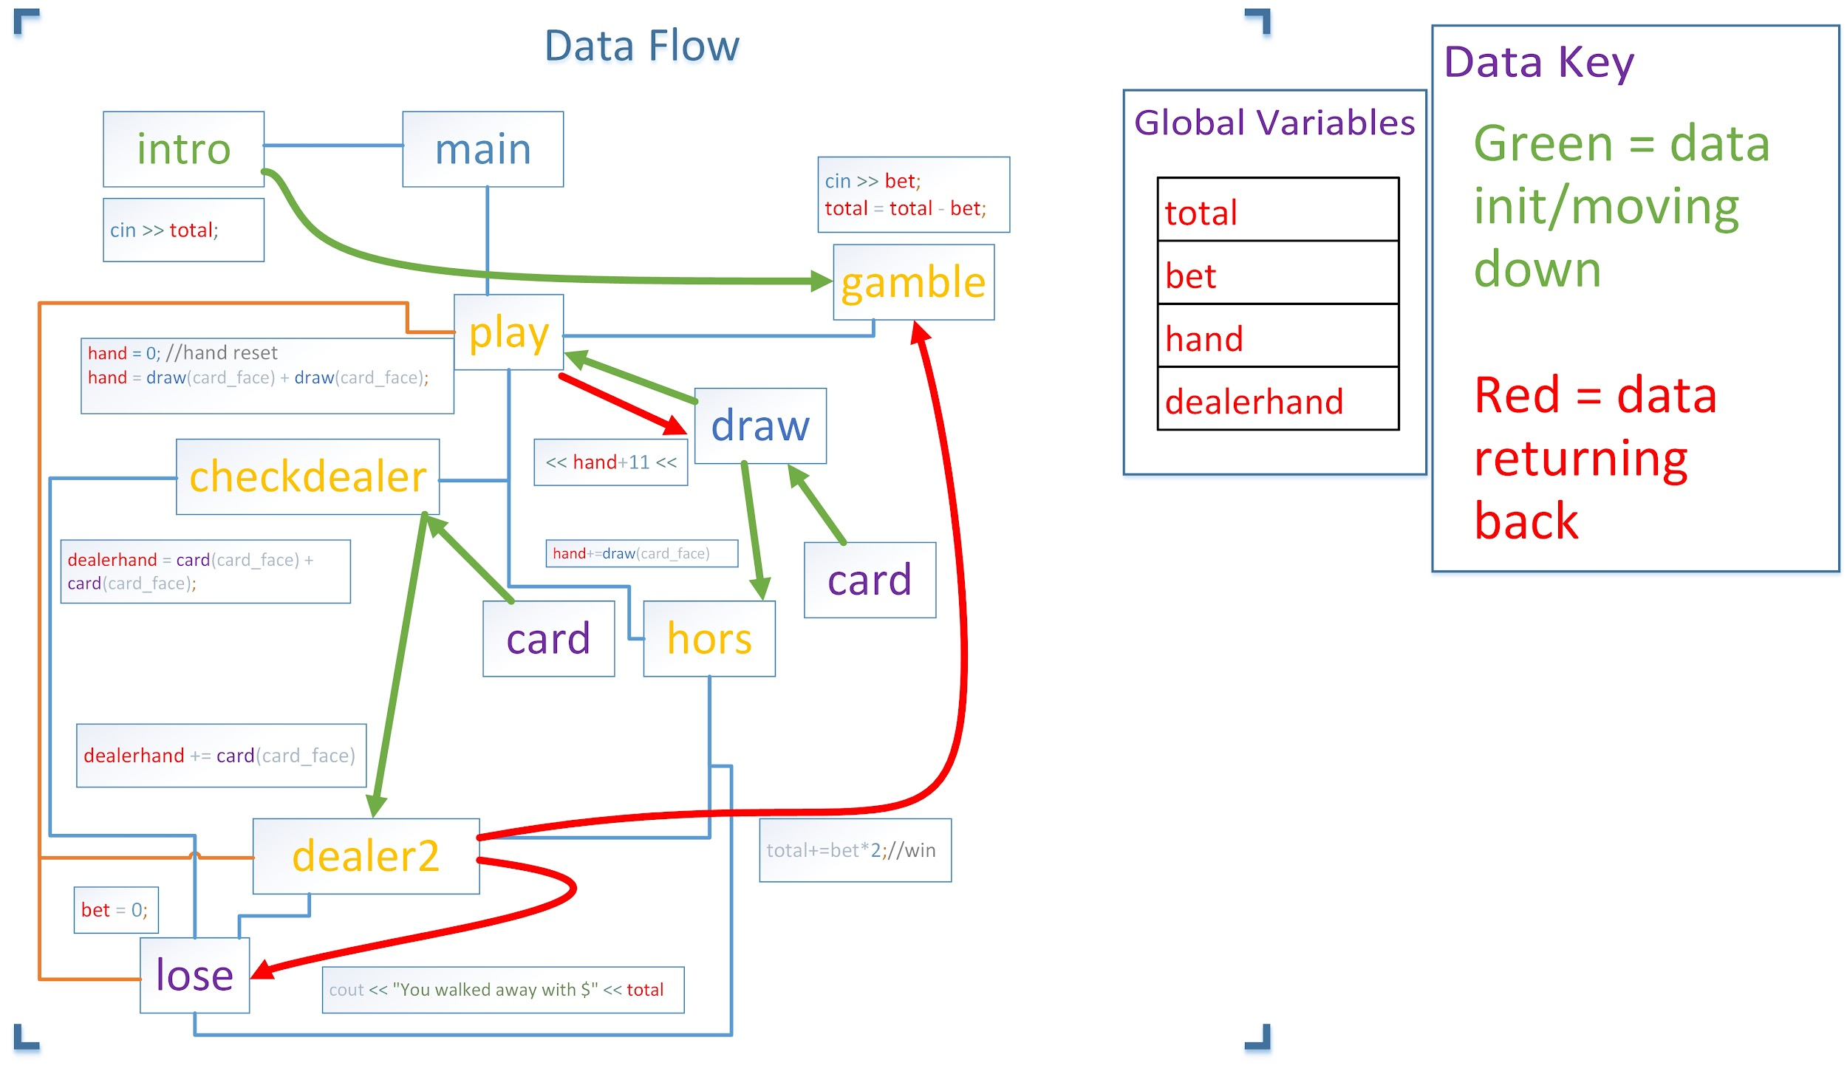
Note:
total is never reset when lose calls play to play again, so lose essentially returns data to gamble.

Slide 8
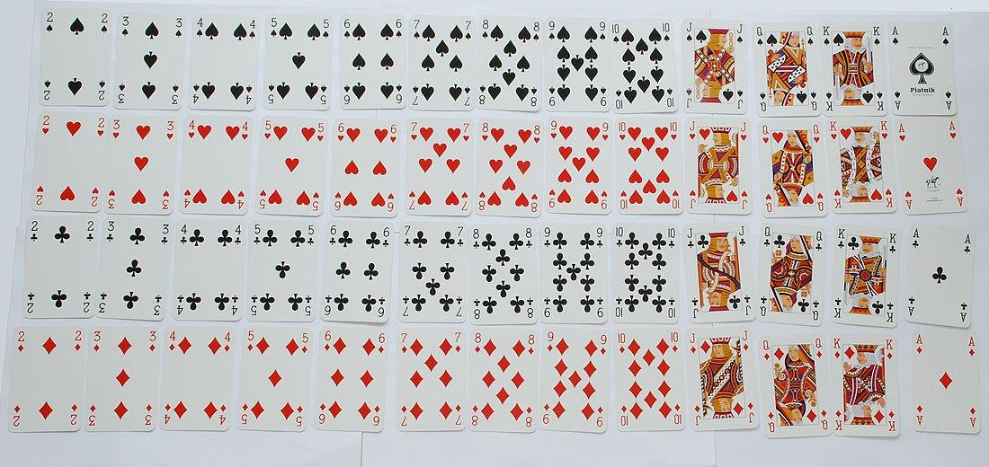

Deck.cpp - card function
A standard deck of 52 cards looks like this:
It has 4 of cards 2-9, plus 4 10s. There are 12 face cards and 4 aces.
In our program, we don’t need to know the suit, face, or anything else about a card other than it’s value in a game of blackjack.
So we create one giant array to represent the deck:
This array has 4 of cards 2-9, 16 10s, and 4 11s. To choose a random card from the deck, all we have to do is get a value from a random indice in the array:
* can’t count cards, deck array never changes

Slide 9
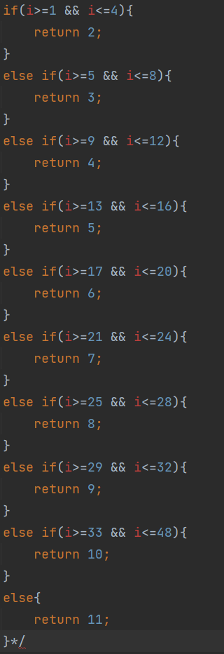
What we learned
Uses for arrays
Using functions to decrease apparent complexity, less repeat code, less overwhelming
srand(time(0)); Needs to be set in main(calling) function otherwise seed is same while code is executing
Sleep(500); Use for sleep command for effect
How to print ACII art in c++
To completely exit the program, we used std::abort since otherwise if return 0 was used it would take the player back to the previous function which would be play again
Card function used to be a huge if else chain. i would be random value between 1 and 52 and the if else chain would determine the card value.

Slide 10
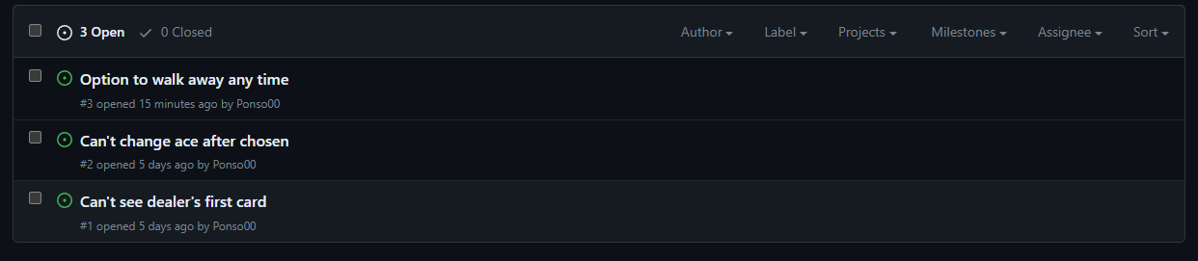
Issues
Blackjack could still use improvement. Feel free to commit to our github repo.
These issues were outside of the scope of the project due to time and resources.

